Slide 1
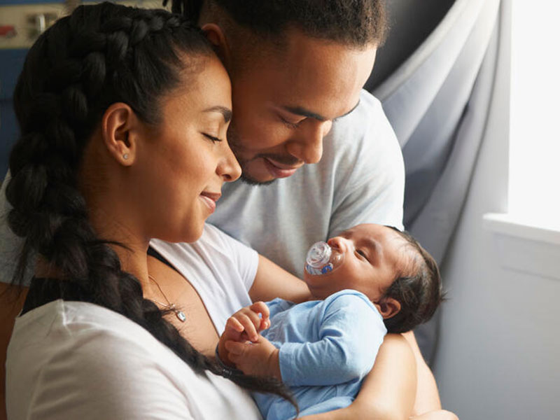
A MECHANISM TO KEEP THE IMMUNIZATION
RATE OF
NEWBORNS
WITH NOVEL
TECHNIQUES VIA REMOTE CONSULTATION
(TMP-23-103)

Slide 2
Progress after proposal presentations
Changes of the components
Information gathering
Field visits
Interviews
Research papers, tutorials
Implementations and integration
Testing

Slide 3
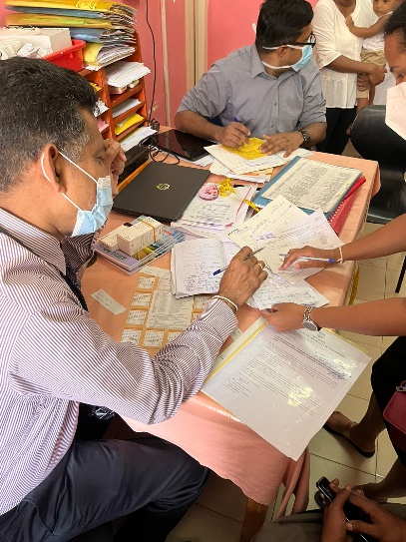
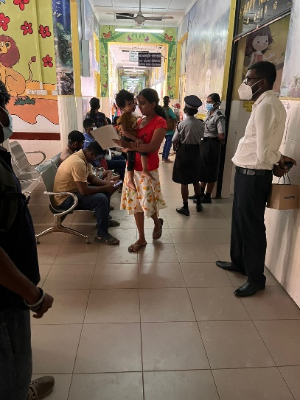
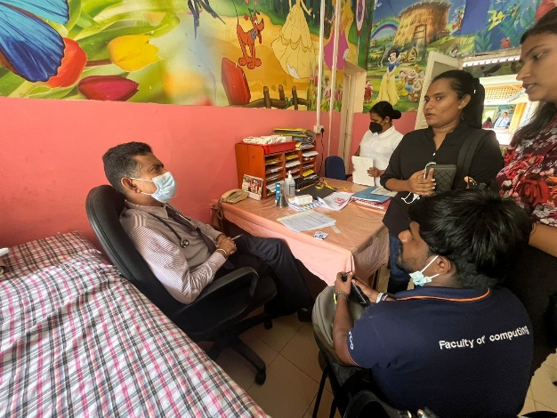
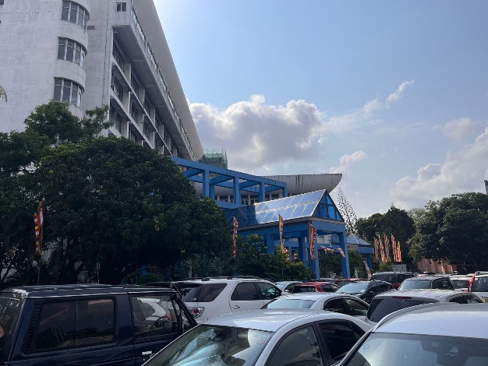
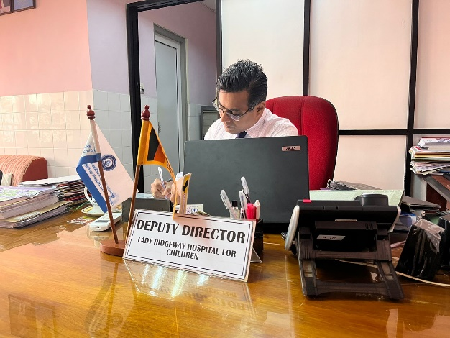
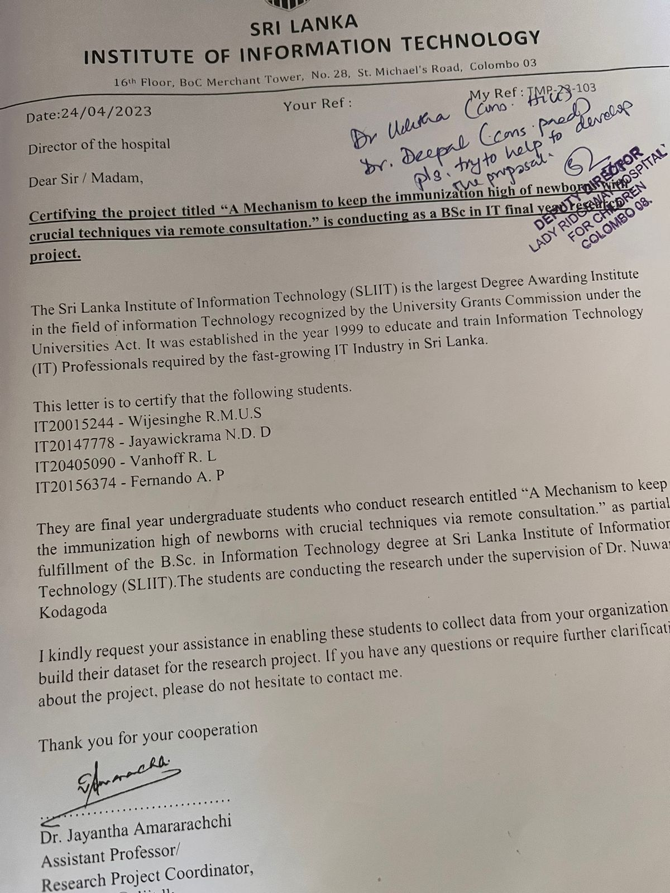
Information Gathering
Interviews
Deputy Director - Lady Ridgeway Hospital
Dr. Uditha - IT Consultant (LRH)
Dr. Deepal - Pediatrition (LRH)
The pediatric clinic was visited at LRH
Visited the Castle Hospital and handed over the necessary documentation for approval to do field visits

Slide 4
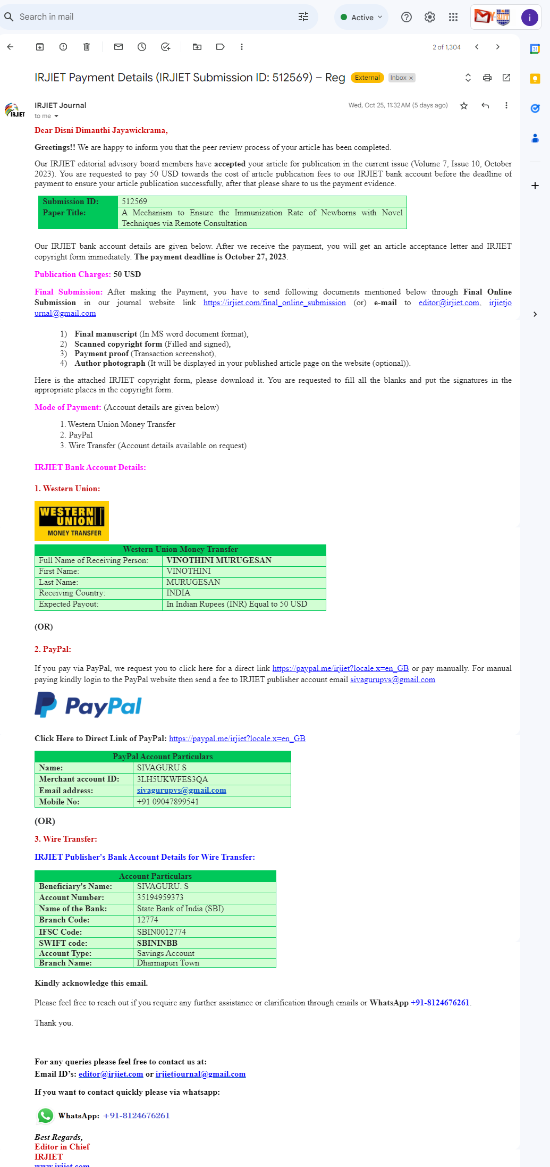
Research Paper

Slide 5

IT20015244 | Wijesinghe R.M.U.S Decentralized Patient Registration.
Software Engineering
IT20015244 | Wijesinghe R.M.U.S | TMP-23-103

Slide 6
Background and Literature
I implement the system to allow parents and health care providers to manage a child's medical and personal information in an efficient and accessible manner. For example, if a child needs to see a specialist, the specialist can quickly access the child's medical history and provide the necessary treatment.
And if you want to view the patient records, you need to request the public key from the patient.
I would implement a permission-based access control mechanism to ensure that only authorized parties can access the data.
By encapsulating all of these features into a single component, the DPR component could be easily integrated into a larger decentralized healthcare system.
IT20015244 | Wijesinghe R.M.U.S | TMP-23-103

Slide 7
Background and Literature cont.
In this application is powered by IPFS, where patients’ medical records are stored on the distributed file system, not owned by any centralized entity. A patient can access his or her records by interacting with a smart contract on the Ethereum blockchain, forming a digital identity of the patient on the decentralized network.
The client first connects with MetaMask, and uses smart contract to mint a patient or doctor block, registered by the wallet address.
The client can upload a record file to IPFS, which address is linked to a patient block in ETH chain. The client can get all record addressed stored in a patient block from smart contract, and get a record file by its address from IPFS.
The health provider can search for a patient’s records using the address, and upload a new record for the patient. The patient can also view his or her records.
A patient or a doctor can access the patient's records by interacting with a smart contract on the Ethereum blockchain.
IT20015244 | Wijesinghe R.M.U.S | TMP-23-103

Slide 8
Research Question
The existing electronic health records management systems suffer from security and privacy vulnerabilities, as patient data is often stored in centralized databases prone to unauthorized access and data breaches. Our research project aims to address this critical issue by leveraging the decentralized and immutable nature of blockchain technology.
How will the system ensure the privacy and security of the data collected?
How will the system ensure that authorized parties have access to the necessary information?
How will the system interface with existing healthcare systems and databases?
IT20015244 | Wijesinghe R.M.U.S | TMP-23-103

Slide 9
Research Novelty
Permission-based access control to ensure that only authorized parties can access the data.
Our solution incorporates advanced cryptographic techniques such as zero-knowledge proofs and homomorphic encryption to enable secure and privacy-preserving data sharing among authorized healthcare providers while keeping patient identities and sensitive information confidential.
The use of blockchain technology ensures that the data is immutable and tamper-proof, providing a high level of security.
We introduce a novel access control mechanism using smart contracts, allowing patients to grant granular access permissions to healthcare providers on a need-to-know basis. The access control rules are enforced autonomously, ensuring data integrity and preventing unauthorized data access.
IT20015244 | Wijesinghe R.M.U.S | TMP-23-103

Slide 10
Methodology
Component overview Diagram
Technology Involved
IT20015244 | Wijesinghe R.M.U.S | TMP-23-103

Slide 11
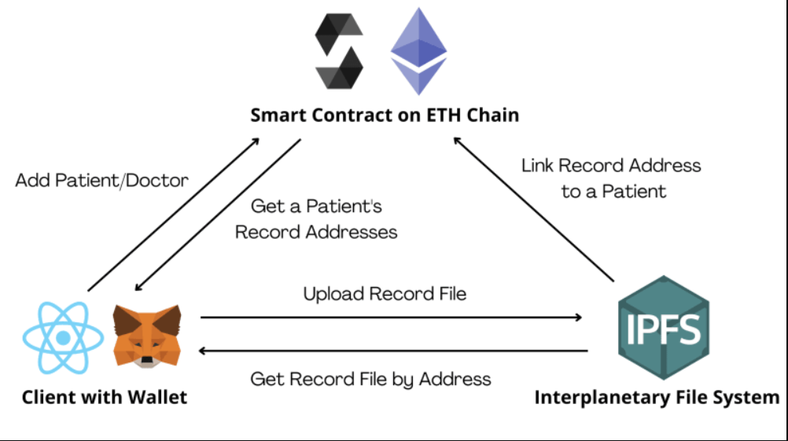
Component Overview Diagram
IT20015244 | Wijesinghe R.M.U.S | TMP-23-103

Slide 12

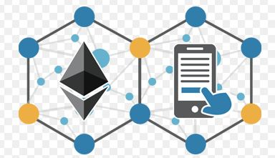


Technology Involved
Frontend
Reactjs, HTML, CSS, Tailwind.
Backend
Solidity and Ethereum Based Blockchain
Hardhat
Database
Web3.Storage,, Inter Planetary File System(IPFS)
IT20015244 | Wijesinghe R.M.U.S | TMP-23-103

Slide 13
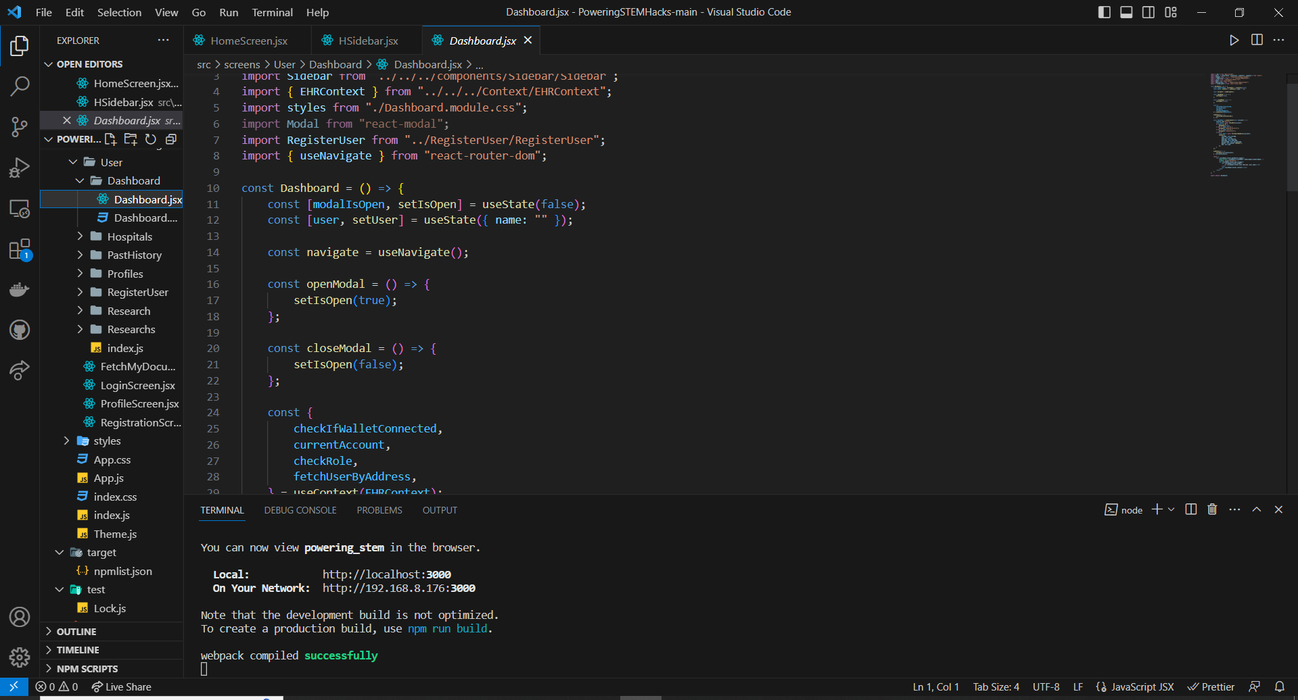
Developed solution
User Dashboard Code
IT20015244 | Wijesinghe R.M.U.S | TMP-23-103

Slide 14
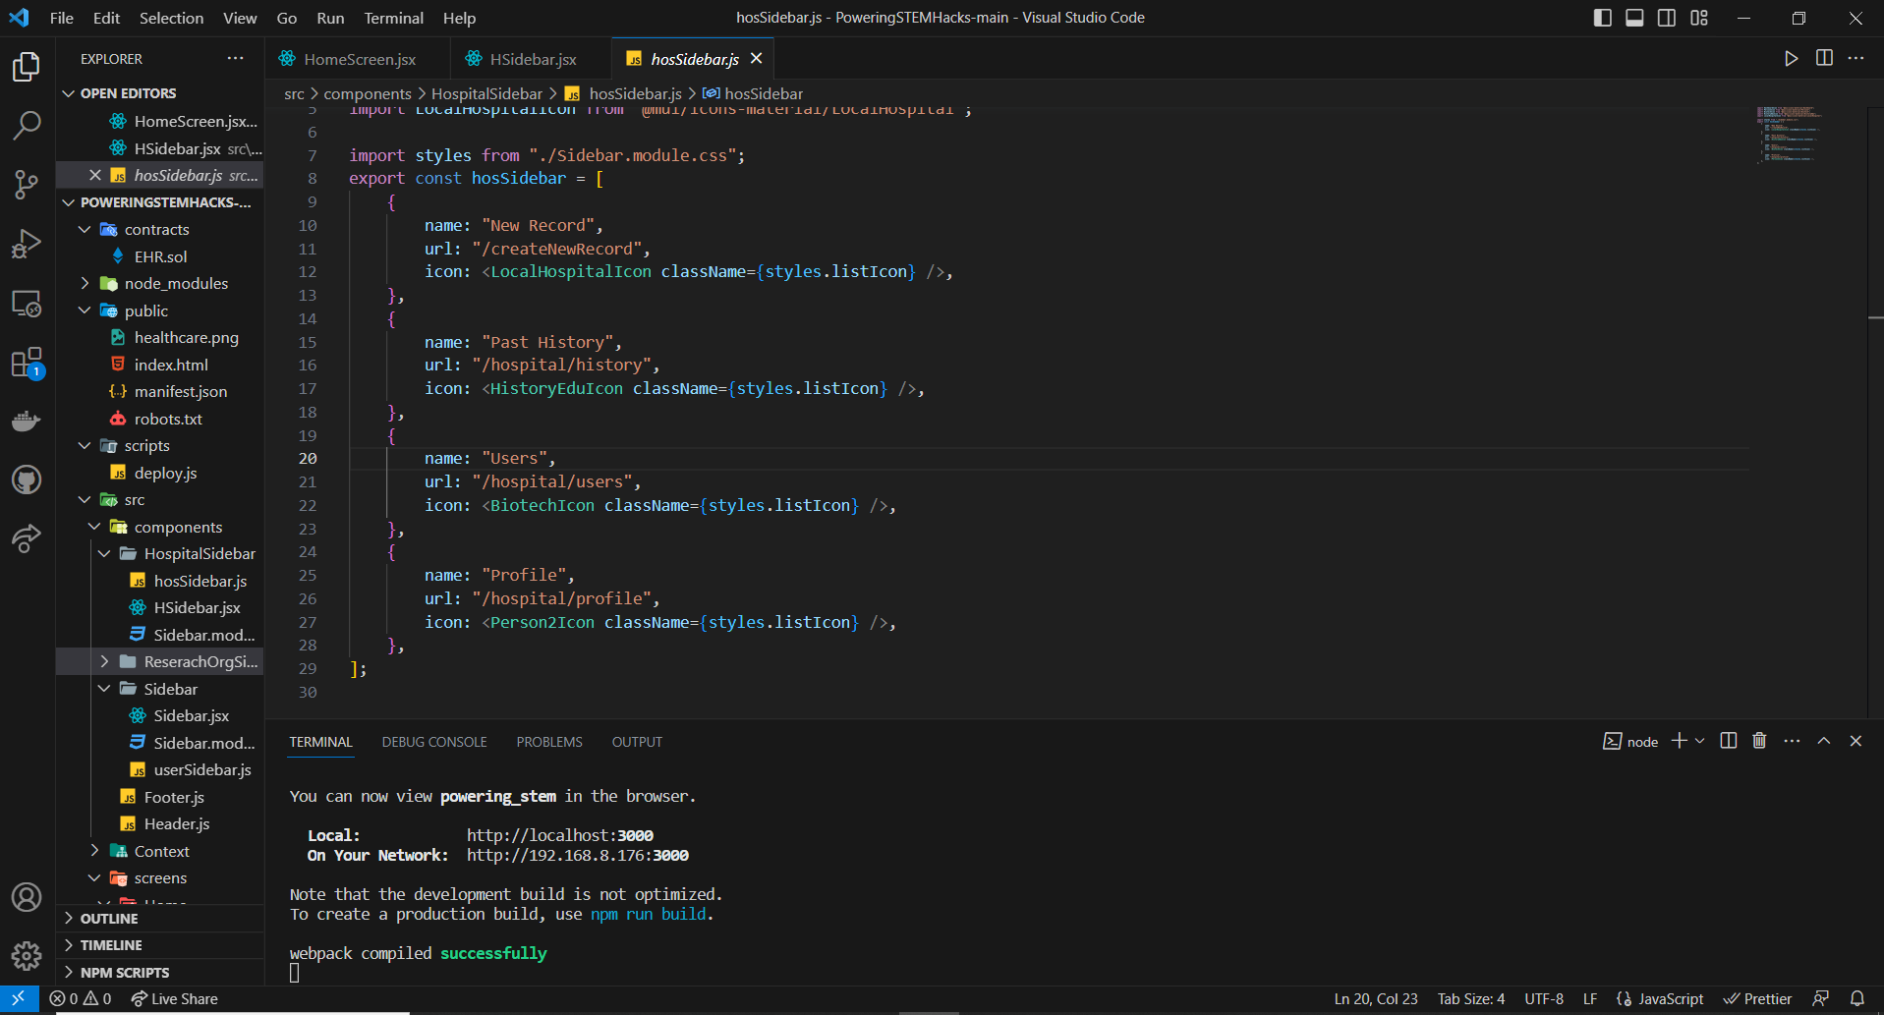
Developed solution
cont.
Hospital Dashboard Code
IT20015244 | Wijesinghe R.M.U.S | TMP-23-103

Slide 15
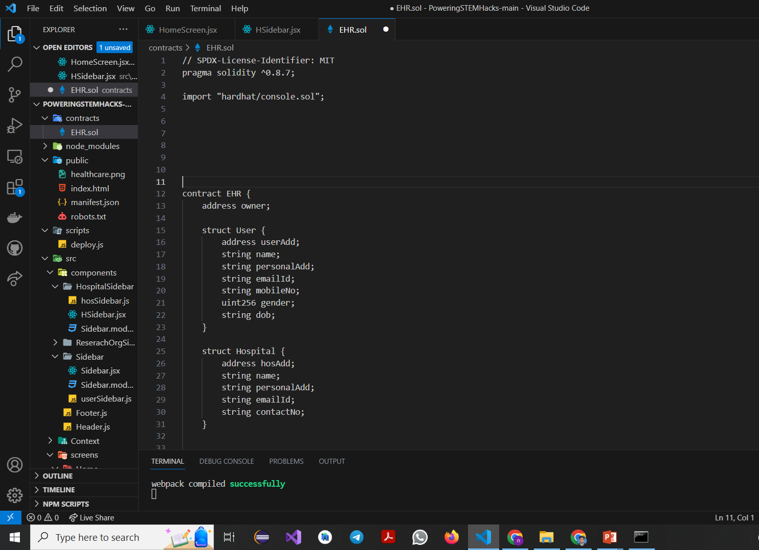
Developed solution
Smart Contract code
IT20015244 | Wijesinghe R.M.U.S | TMP-23-103

Slide 16
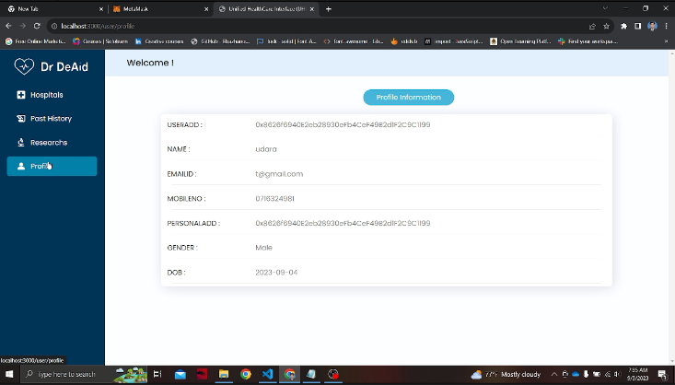
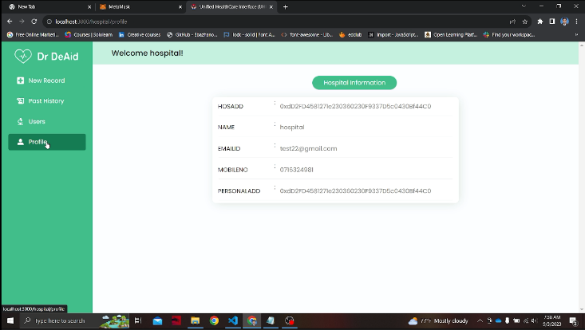
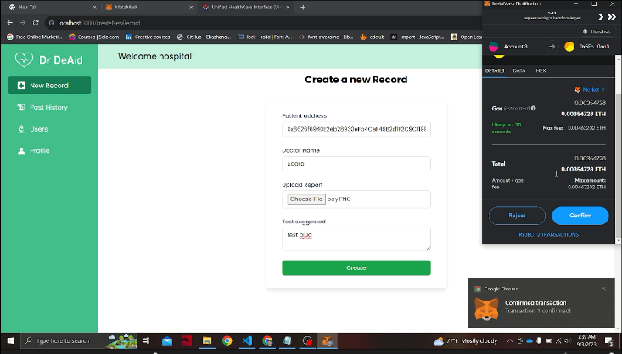
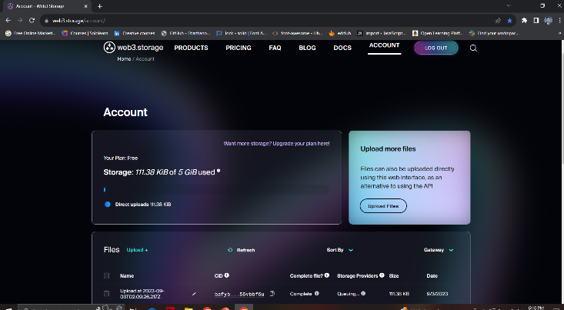
Results and Discussion
IT20015244 | Wijesinghe R.M.U.S | TMP-23-103

Slide 17
References
Secure decentralized electronic health records sharing system based on blockchains: https://www.frontiersin.org/articles/10.3389/fbloc.2021.732112/full
Secure decentralized electronic health records sharing system based on blockchains: https://www.sciencedirect.com/science/article/pii/S1319157821001051.
C C Darshan Thimmaiah, D. S. (2019). Decentralized Electronic Medical Records. IJRAR, 7.
Catherine Quantin, G. C. (2009). Centralised versus Decentralised Management of Patients' Medical Records. researchgate, 6.
Jihui Shi 1, S. K. (2022). A Novel Block Chain Method for Urban Digitization. International Journal of Environmental, 19.
Syed Agha Hassnain Mohsan, A. R. (2021). Decentralized Patient-Centric Report and Medical Image. International Journal of Environmental, 18.
Zhang P, White J, Schmidt DC, Lenz G and Rosenbloom (2018), FHIR Chain: Applying Blockchain to Securely and Scalably Share, Computational and Structural Biotechnology Journal, 16: 267-278
Crypt Bytes Tech (2017), Medical Chain - A blockchain for electronic health records. https:// medium.com/crypt-bytes-tech/medicalchain-a-blockchain-for-electronic-health-recordseef181ed14c2.
Ekblaw A, Azaria A, Halamka JD and Lippman A (2016), A Case Study for Blockchain in Healthcare: “MedRec” prototype for electronic health records and medical research data. MIT Media Lab
‌
IT20015244 | Wijesinghe R.M.U.S | TMP-23-103

Slide 18

IT20147778| Jayawickrama N.D.D
Health Informatics Chatbot Application
Software Engineering

Slide 19
Background and Literature
Introduction and Background
The proposed component is to assist the parents of babies who are having a hard time managing their time.
The system enables parents to ask questions about their infants’ behaviors, any medicine, related remedies, or any other assumption or methods of how exactly to react to an emergency situation.
By the image processing technique, the chatbot can identify the skin infections of the kid by analyzing a clear uploaded photo.
Chat bot will also notify the vaccination days according to the data records it gets from the decentralized system.
From this specific component, the main target is to introduce an assistant that is available beyond the time, helps to manage the time, to reduce the unnecessary cost of doctor appointments, and assist the parents in their problematic situations as a trained health care agent.
User Workflow
Parent approach to the chatbot provided the problematic situation they have faced.
The chatbot system takes the input as data, asks relevant questions to understand the situation, and comes to a final prediction.
Then the suggestions will be displayed as an answer to the problem. This suggestion can be advice, a prediction of a disease, a history record, a remedy, a medicine, or a contact detail of a relevant doctor.

Slide 20
Background and Literature cont.
Benefits for Parents
Time and cost Management: This system will reduce the unnecessary amount of time and the cost for the travel to hospital.
Early Detection: By capturing and analyzing the parents’ data, the system can predict the sicknesses and suggest solutions.
Availability: Unlike doctors, the system is available for the user without any appointments and without time consideration.
De-stress mental health: System existence is to decrease the problematic and emerging situation and to smoothly handle it.
Impact and Future Scope
The system touches the sensitive area of the health industry by predicting the sickness of infants.
This method can be recognized as remote consultation via telecommunication, and with the reliability of the prediction, the system may perform an important role as an assistant for the parents of the newborn child.
Through the training model that contributes with AI and ML algorithms, Image processing techniques, and NLP processing techniques, the accuracy, reliability, and user-friendliness o the system can be optimized.
IT20156374| Fernando A.P. |TMP-23-103

Slide 21
Information Gathering
Number of interview sessions were conducted to finalize the component by the field specialists.
Dr. Christine Buddhini – Panadura Hospital
Dr. Thilini Amarathunga - Muttur Hospital
Dr. Deepal – LRH hospital
Research was conducted after the comments of the panel and the specialists.
Existing systems
Research papers
Video tutorials
For the implementation, tutorial videos, blogs, and chatbot documentation are followed.
IT20405090 | Vanhoff R.L.| TMP-23-103

Slide 22
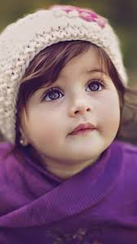
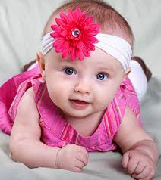
Research Problem
Chatbot Application for Assisting and Guiding Infant Parents
User Interaction and Engagement: How can you design the chatbot to effectively engage with parents and provide them with relevant information and advice regarding infant care?
Content and Information: What kind of information should the chatbot provide to parents? How can you ensure the information is accurate and up-to-date?
Skin Rash Disease Identification from Uploaded Images
Image Processing and Recognition: How can you build an accurate image recognition system capable of identifying various types of skin rashes?
Database and Training Data: What kind of database and training data do you need to train the image recognition model effectively?
Accuracy and Reliability: How can you ensure the system's accuracy and reliability in identifying skin rash diseases?
Legal and Medical Regulations: Are there any legal and medical regulations that need to be considered when developing and deploying a system for disease identification?

Slide 23






Component Overview Diagram
Intent Recognition NLU Providers
Chatbot Modeling Language
Chatbot user
Intent Package
Chatbot Runtime
uses
uses
Execution Package
GUI-to-text
uses
Backend Services
Software Engineer
Backend Models

Slide 24

Methodology – Chat-bot
Regular Expressions (regex): The re module is used for text processing and pattern matching using regular expressions. Here, it's used to split user input into words or tokens.
Natural Language Processing (NLP): NLP is a key technology in chatbot development. NLP techniques are used to understand and generate human-like text responses. Libraries like NLTK (Natural Language Toolkit) used for NLP tasks.
3. Response Generation: Based on predefined patterns and keywords provided in the check_all_messages function. It uses a rule-based approach, matching user input to predefined responses.
4. External Module (long_responses): An external module named long_responses which contains longer response messages. This module seems to contain detailed responses for various user queries. This demonstrates modularity separating responses from the main logic.

Slide 25
5. Interactive Loop: An interactive loop, continuously accepting user input and providing responses until the user types "exit.“
6. Chatbot Logic: The core logic of the chatbot involves matching user input to predefined keywords and selecting the response with the highest probability. It also checks for required words to ensure that certain conditions are met before providing a response.
7. Exit Command Handling: A mechanism to exit the loop when the user inputs "exit," allowing the user to quit the conversation.
Flask: Flask is a micro web framework for Python. It's used here to create a web server that handles HTTP requests and responses.
MongoDB: MongoDB is a NoSQL database used to store chat conversations. The pymongo library is used to connect to and interact with the MongoDB database.
HTML and Jinja2 Templates: HTML is used to create the structure of the web page, and Flask uses the Jinja2 template engine to dynamically generate HTML content and render it on the web page.
JSON (JavaScript Object Notation): JSON is used for data exchange between the web page and the Flask server. The jsonify function from Flask is used to send JSON responses to the client.

Slide 26
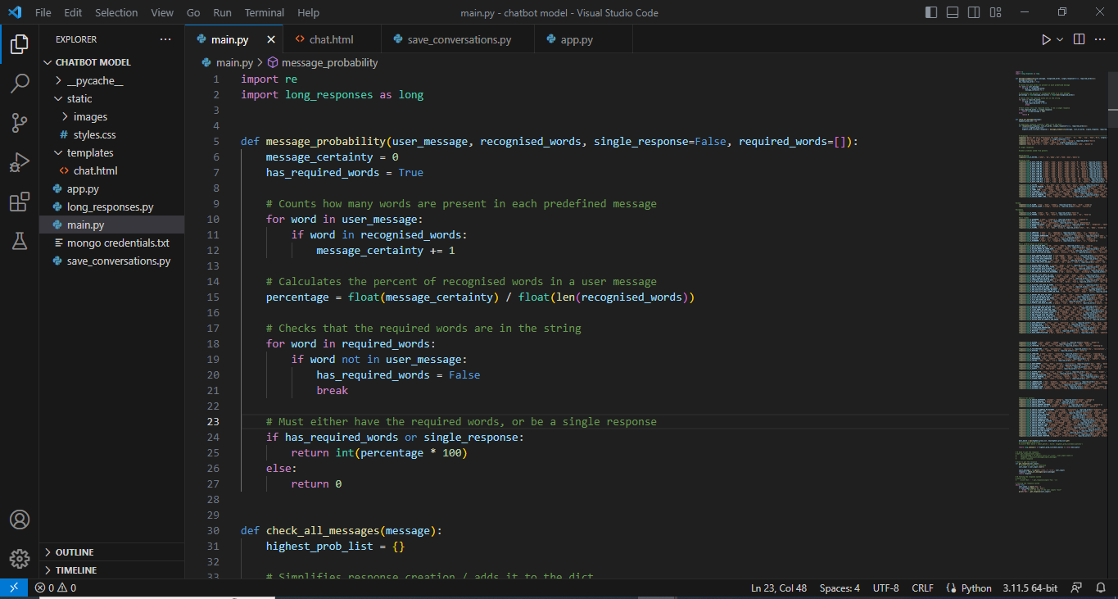
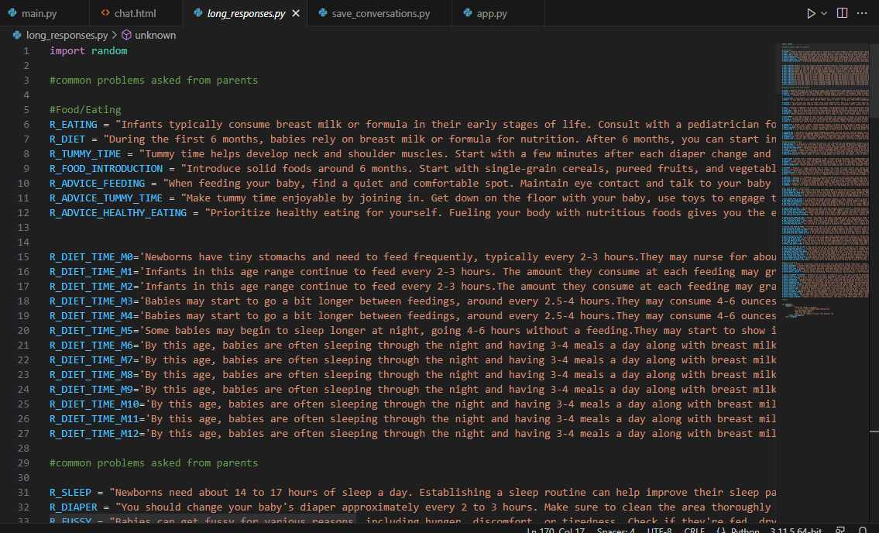
Developed solution – chat bot
Model.py
long_responses

Slide 27
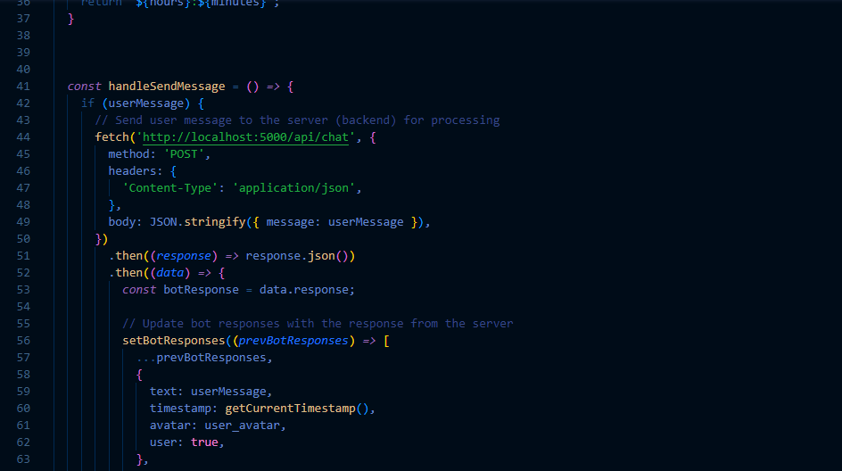
Chat file
This code uses by the user interaction
React

Slide 28
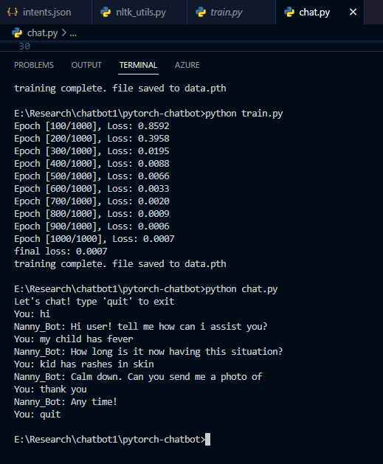
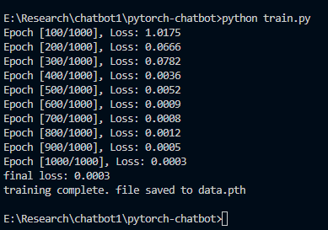
Final output
Training result

Slide 29
Methodology – Skin Rashes Prediction
Flask: Flask is a micro web framework for Python. It's used to create a web server that handles HTTP requests and responses.
NumPy: NumPy is a Python library for numerical computations. It's used for mathematical operations, especially in the context of machine learning.
TensorFlow and Keras: TensorFlow is an open-source machine learning framework, and Keras is an API that runs on top of TensorFlow. The code uses Keras to load a pre-trained skin rash classification model and make predictions based on uploaded images.
Werkzeug: Werkzeug is a utility library for Python web applications. It's used here for secure file uploads.
HTML Templates: The code includes HTML templates to render web pages for uploading images and displaying results. It uses the Jinja2 template engine, which is integrated with Flask.
Static Files: Static files, such as CSS stylesheets and images, are served using Flask's static_url_path configuration.
File Uploads: Flask handles file uploads from users, allowing them to upload skin rash images for classification.

Slide 30
Model Loading: The code defines a function to load a pre-trained skin rash classification model stored in an H5 file. The model is loaded using Keras.
Image Preprocessing: Images uploaded by users are preprocessed before being fed into the model. The preprocessing includes resizing the image to a specific target size and normalizing pixel values
Model Prediction: The code uses the loaded model to make predictions on uploaded images. It assumes that the model outputs probabilities for different skin rash types and selects the class with the highest probability as the predicted class.
Allowed File Extensions: It checks if the uploaded file has a valid image file extension (e.g., .jpg, .jpeg, .png) to ensure that only valid image files are processed.
Error Handling: The code handles various error cases, such as when no file is selected or when an invalid file format is uploaded. It provides error messages to the user.
Rendering Results: After making predictions, the code renders a results page that displays the uploaded image and the predicted skin rash type.
Running the App: The code includes a block to run the Flask application when the script is executed.

Slide 31
Prediction
Atopic Dermatitis
Bullous Disease
Cellulitis Impetigo and other Bacterial Infections
Eczema, Exanthems and Drug Eruptions
Urticaria Hives
Normal Skin
Normal Skin
Abnormal Skin

Slide 32


Training file
TensorFlow and Keras
NumPy
Matplotlib
Pandas
ImageDataGenerator
Google Colaboratory
File Management
Convolutional Neural Networks (CNNs)
Data Augmentation
One-Hot Encoding
Plotting
Google Drive Integration
Model Saving

Slide 33
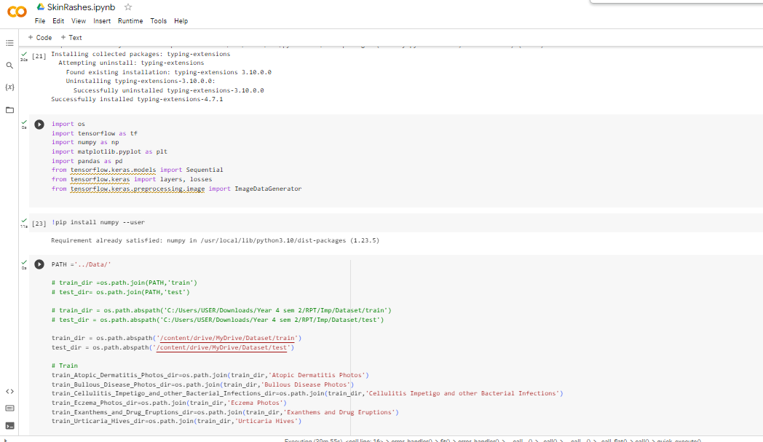
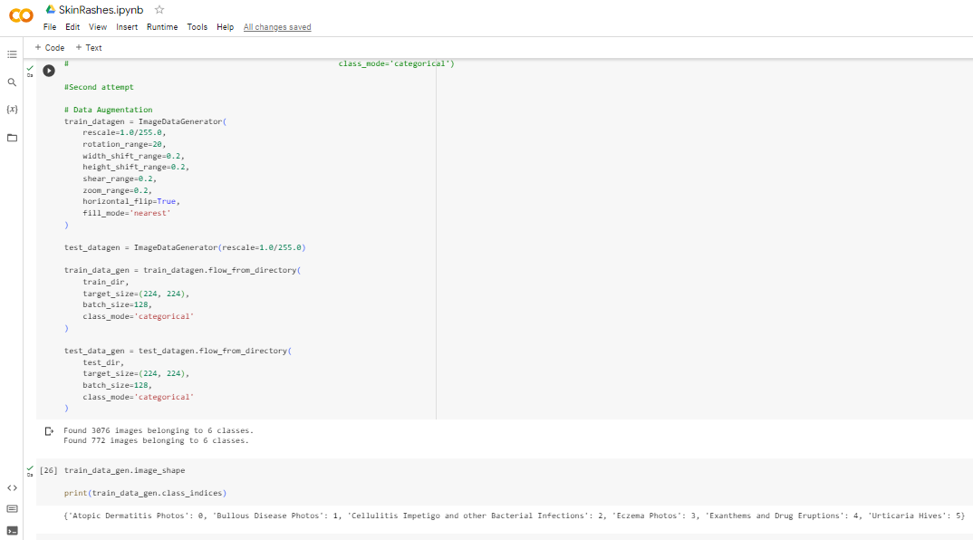
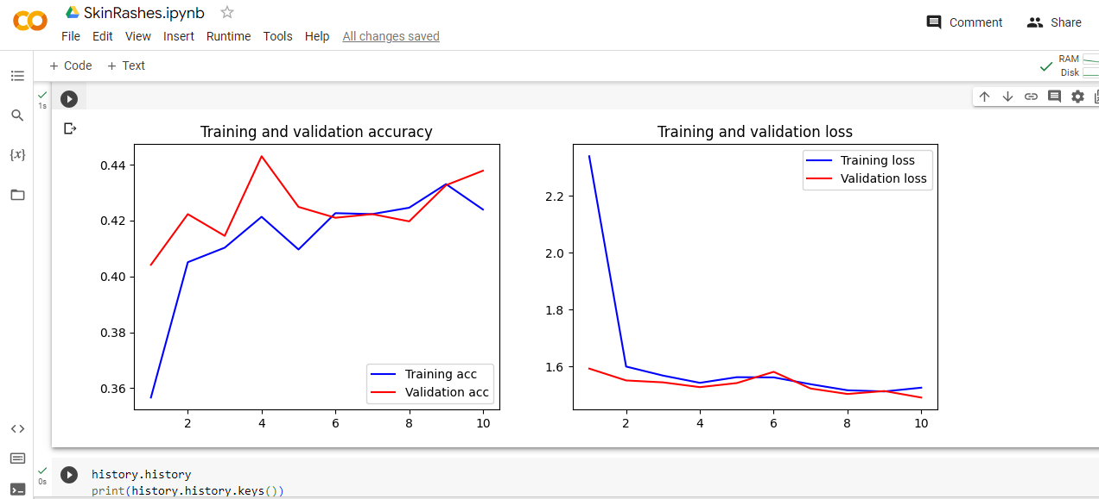
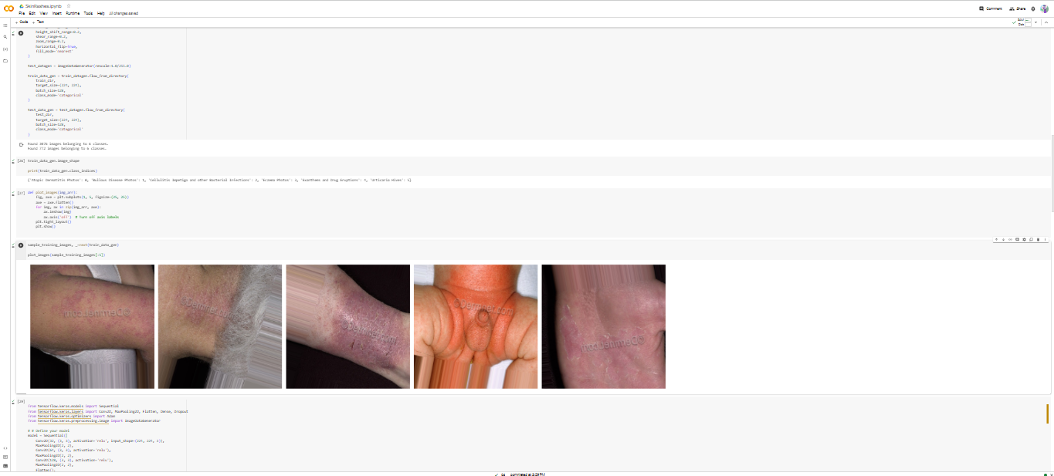
Developed solution – skin rashes prediction

Slide 34

Results and Discussion

Slide 35
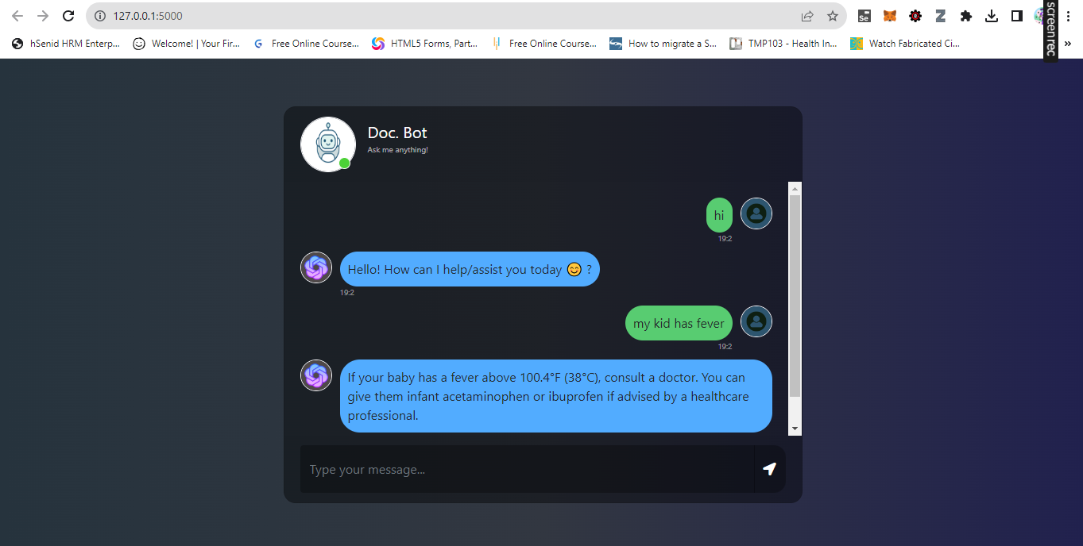
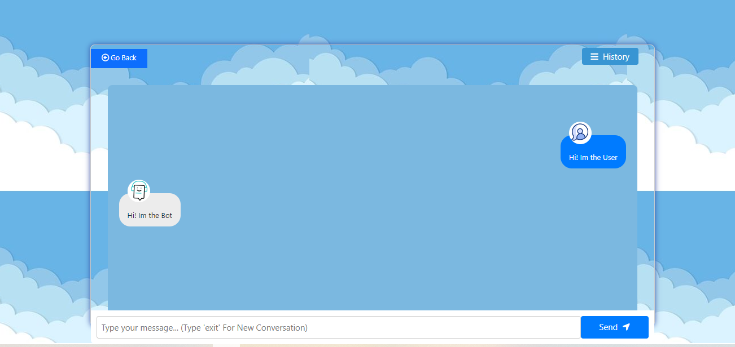
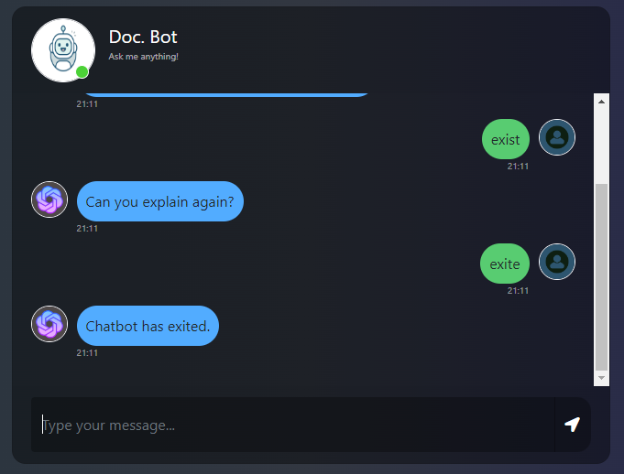
Results and Discussion – Chat bot

Slide 36
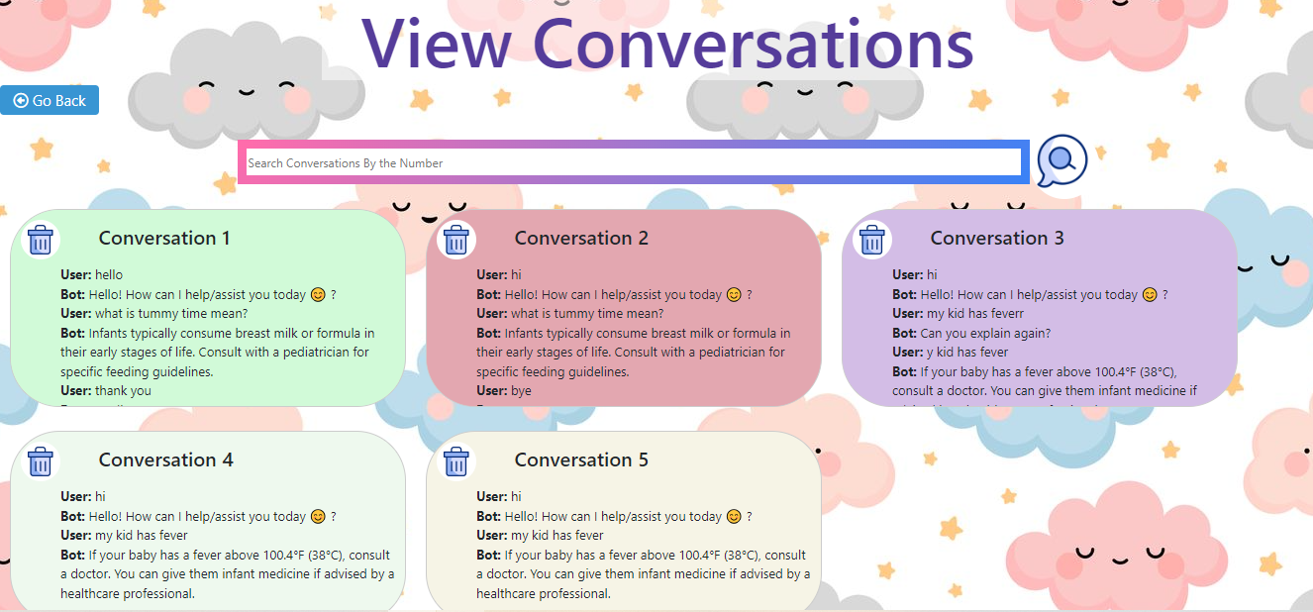
New Feature- History of Chats

Slide 37
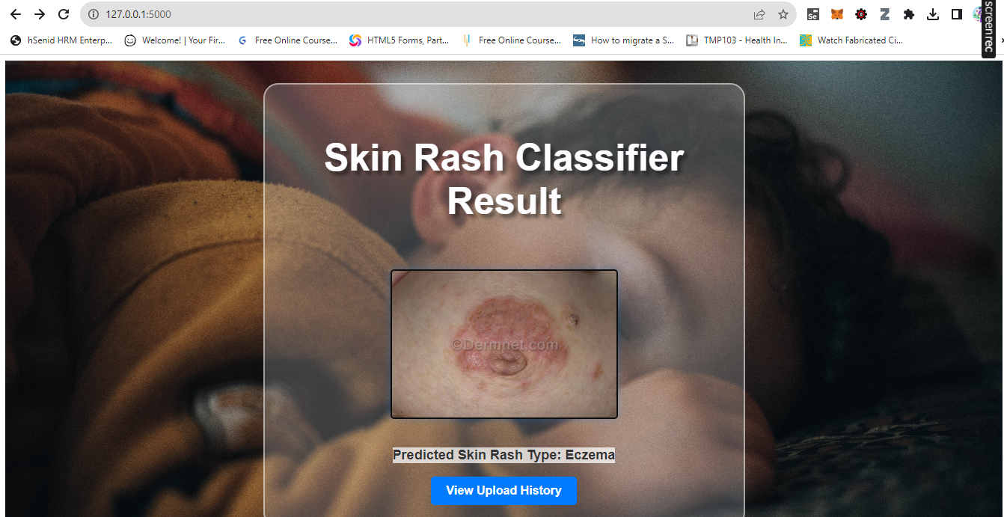
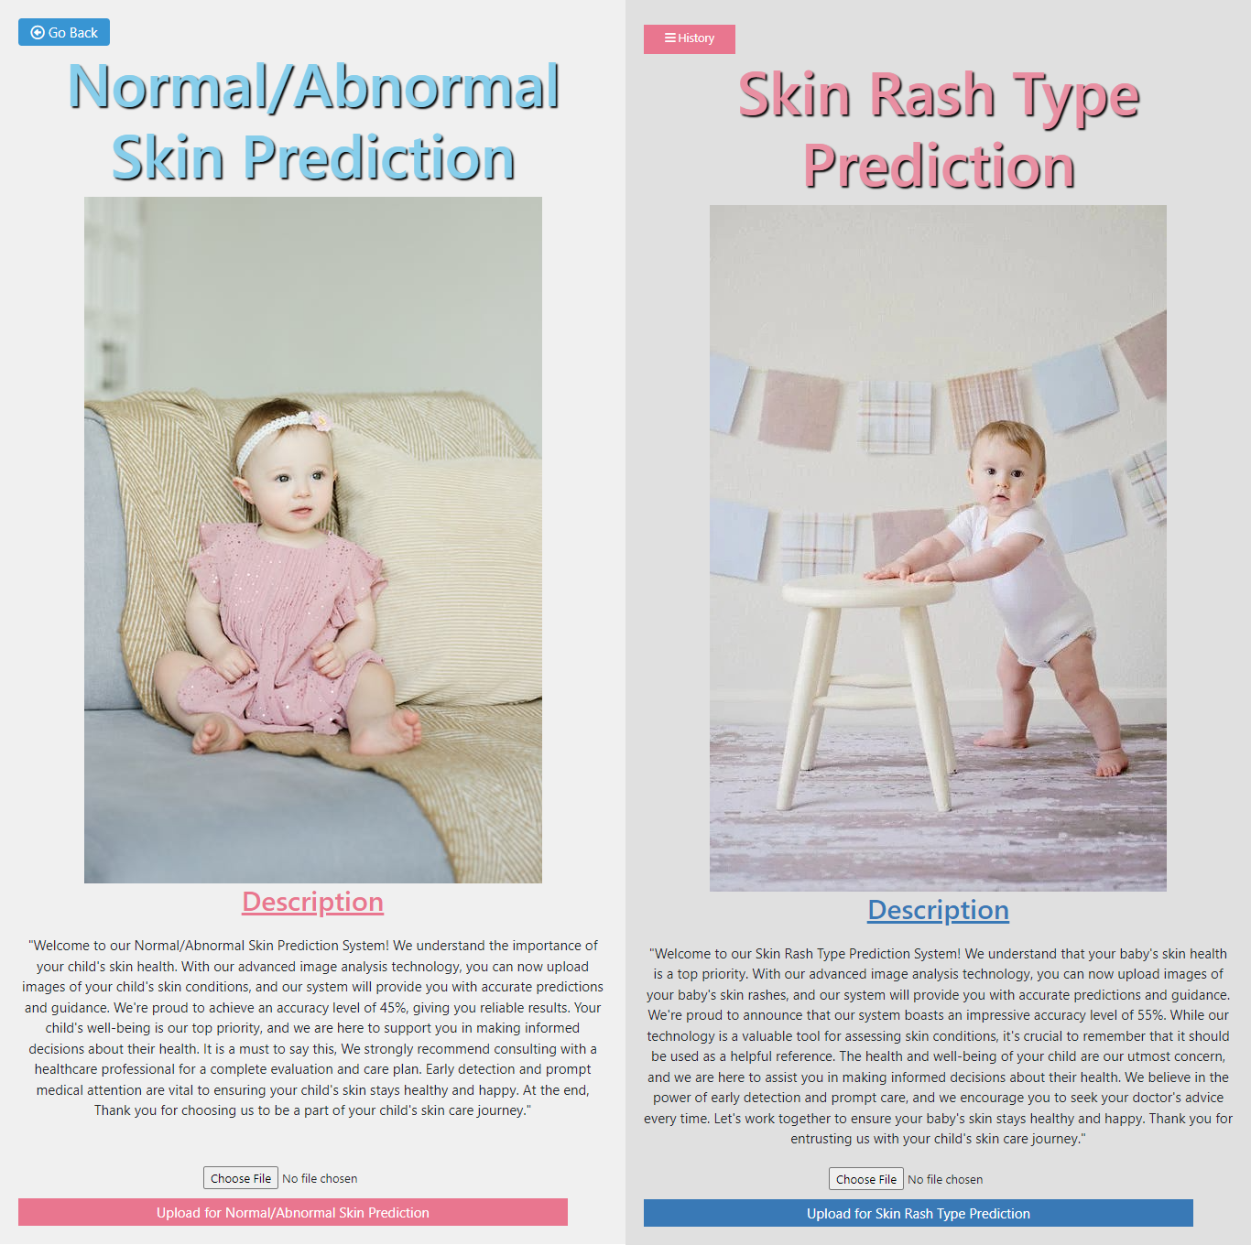
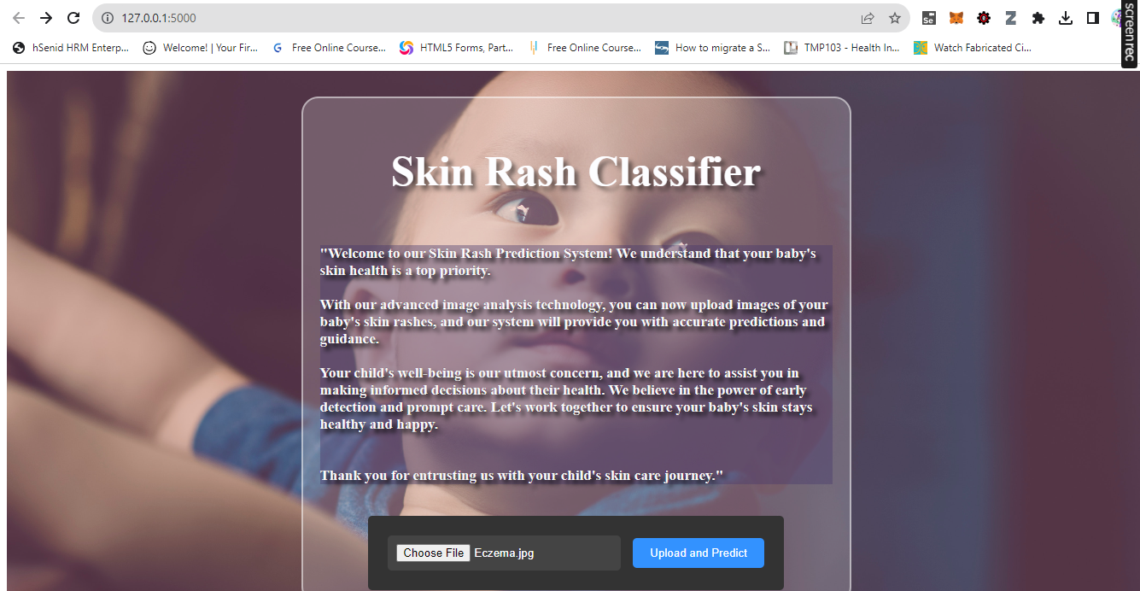
Results and Discussion – Skin Rashes Prediction

Slide 38
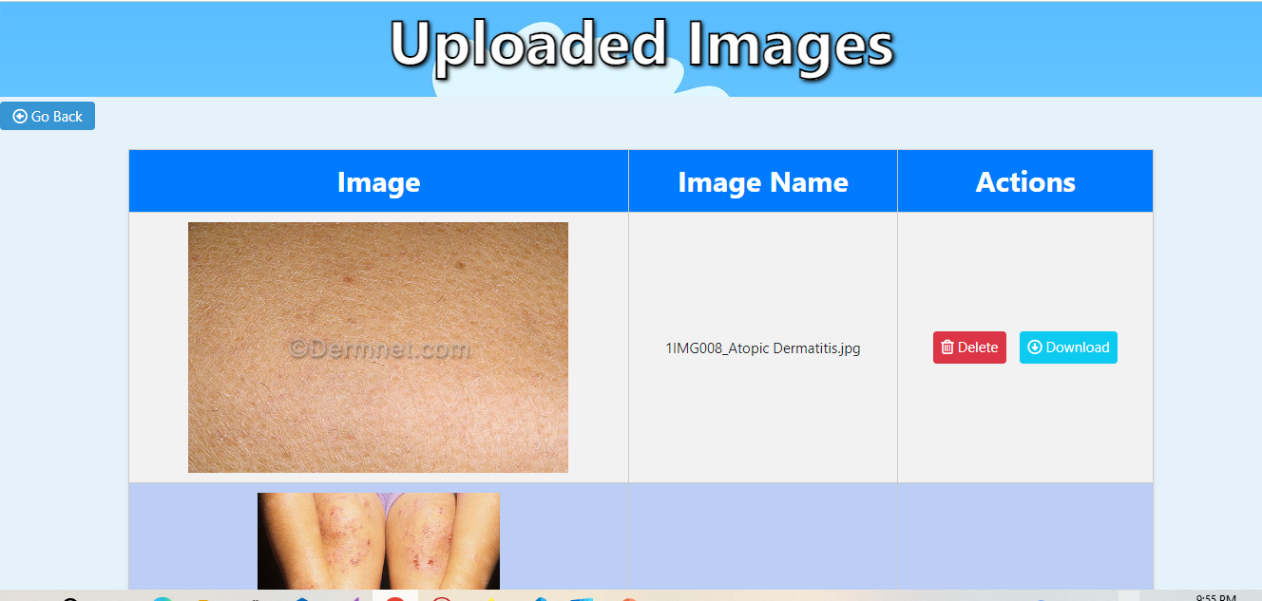
New Feature- History of Images

Slide 39

IT20405090 | Vanhoff R. L.
Growth Level Prediction
Software Engineering
IT20405090 | Vanhoff R.L.| TMP-23-103

Slide 40
Background
After the proposal presentation the component was asked to change to a growth level predictor instead of a nutritional level identification and the functionality was changed from image processing to training a model to predict the growth level, by the panel and after the pp2 the graph feature was added.
Information was gathered from the specialists and doctors in order to gather information for the predictions to make it more accurate and to discuss on how the functionality can be done.
But after the process, it was stated that the growth level cannot be measured without the height, weight and age-appropriate other measures with just the behavioral milestones.
As the final decision, the component was changed to a prediction function where according to the given measures of a child, the growth level can be predicted by the model.
IT20405090 | Vanhoff R.L.| TMP-23-103

Slide 41
Information Gathering
Several interviews were held with the doctors to discuss about the changed function before finalizing the component.
Dr. Udara Ariyasinghe - Arogya Family Medical Center
Dr. Thilini Amarathunga - Muttur Hospital
Dr. Dileepa Fernando – Badulla Hospital
Dr. Daphnie Fernando (UK)
Investigations were done by exploring the available systems, past research papers, tutorials and other related materials to get a clear understanding about doing predictions using a model.
Referred online materials such as YouTube videos, online surveys, WHO documentation and other medicine related documentation to use the correct information to train the model and start the implementations.
IT20405090 | Vanhoff R.L.| TMP-23-103

Slide 42

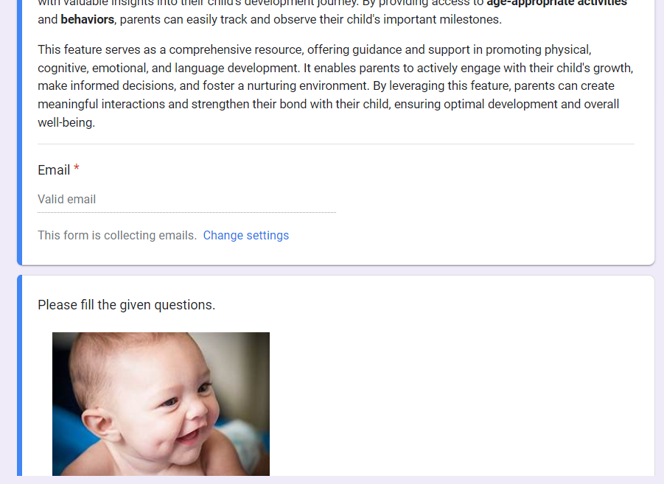
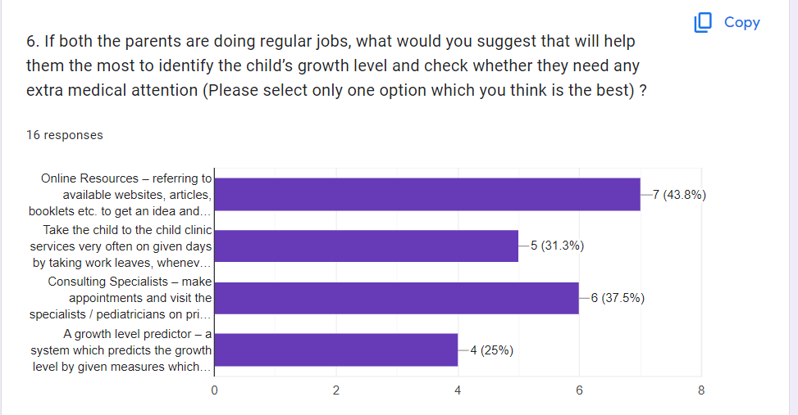
A private clinic at Moratuwa was visited in order to get the parents’ feedback on the idea and the implementation of the system with the permission of the doctor using a google form [1].
16-18 responses were received initially, and the same clinic was used for user testing after implementations.

Slide 43






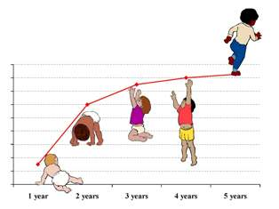
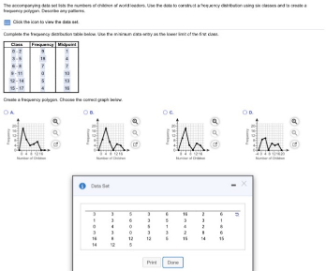

Component Overview Diagram
Output will be displayed as a prediction
Input data will be entered by the parents
Machine Learning Model
Process data
Train the Machine Learning model using a dataset
IT20405090 | Vanhoff R.L.| TMP-23-103

Slide 44


Model Overview
Age , Height, Weight
Generated graphs for the child, based on predictions
Growth prediction of the child (based on the given inputs)
Physical+ Cognitive + Emotional + Language
(16 columns)

Slide 45
Component Discussion
The Function's Primary Goal - The purpose is to give parents an automated method for determining and tracking their infants' growth levels. The function estimates the developmental stage based on several factors about a kid, including weight, height, age, and other development milestones.
The following are the function's main objectives:
Development Level Prediction: The Random Forest Classifier method, a machine learning approach, is used by the function to forecast newborns' development levels. The function trains a classifier model to precisely forecast the growth level based on the input measurements by examining the provided dataset, which comprises development milestones data for children aged 0–5 years.
Precautionary Measures: If the expected growth level suggests overgrowth or undergrowth, the function is intended to help parents take the appropriate safety measures. Parents can better comprehend their baby's development and seek the necessary medical advice or intervention by having insights about the child's growth trajectory.
User-Friendly Interfaces: The function is incorporated into a user-friendly front-end web application that is a full-stack web application. Parents may easily input their baby's measurements into the interface to get a prediction of growth level. To make it simple for parents to understand and respond to the results, the interface also displays the forecast as a % along with corresponding categories of poor, fair, good, and excellent.
By emphasizing these crucial elements, the function intends to give parents a useful and instructive tool for tracking their child's development and encouraging proactive healthcare management.
IT20405090 | Vanhoff R.L.| TMP-23-103

Slide 46
Component Discussion cont.
User Workflow
Enter Child's Information: Provide the child's age, height, weight, and select or input information about their developmental milestones in various domains, such as motor skills, problem-solving, communication, and emotional development.
Predict Growth Level: Click the "Predict the Growth" button to initiate the prediction process. The system will process the entered data and calculate the child's growth level.
View Result: Once the prediction is complete, view the predicted growth level displayed on the screen. Take note of the result and any recommendations provided by the application.
Impact and Future Scope
Impact:
Empowers parents with valuable insights into their child's progress.
Enables early detection of developmental delays or potential issues.
Facilitates timely interventions and support.
Promotes proactive parenting by offering personalized recommendations.
Contributes to informed decision-making for child development.
Future Scope:
Calculation of different milestones and personalized recommendations.
Expansion of assessed milestones and incorporation of machine learning techniques.
Integration of a comprehensive growth database for accurate comparisons.
Inclusion of educational resources and interactive features.
Continuous evolution and advancements as a valuable parenting tool.
IT20405090 | Vanhoff R.L.| TMP-23-103

Slide 47
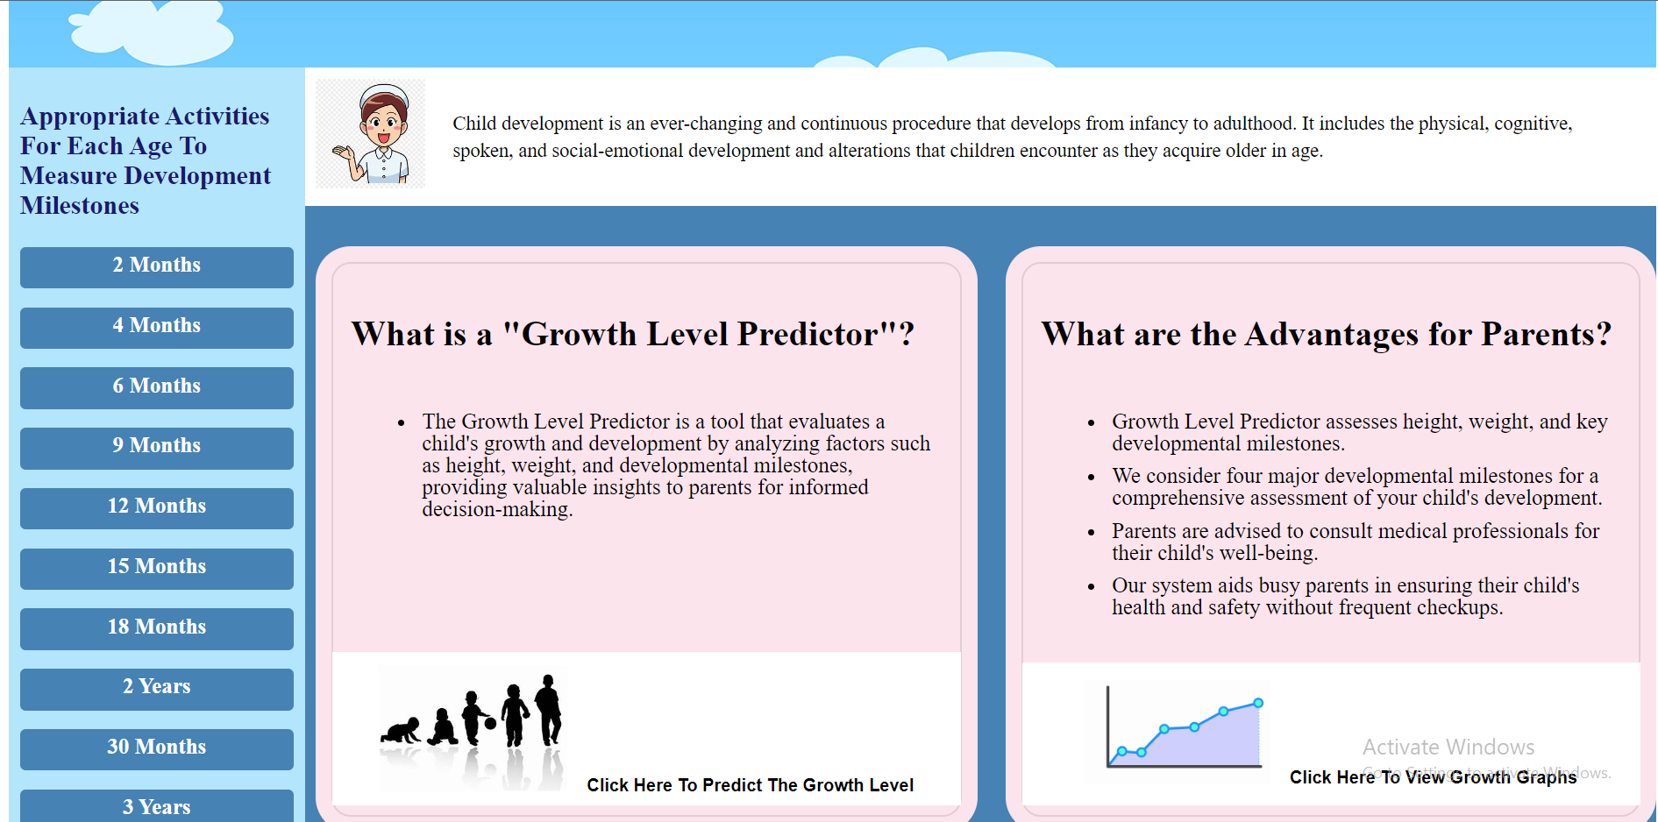
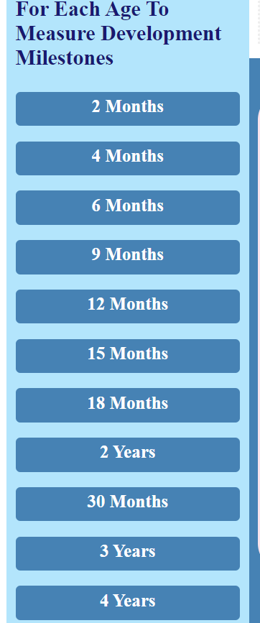
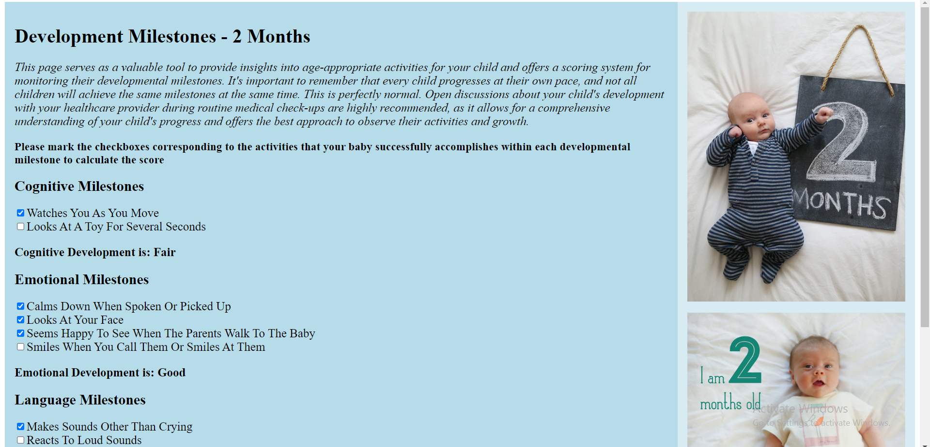
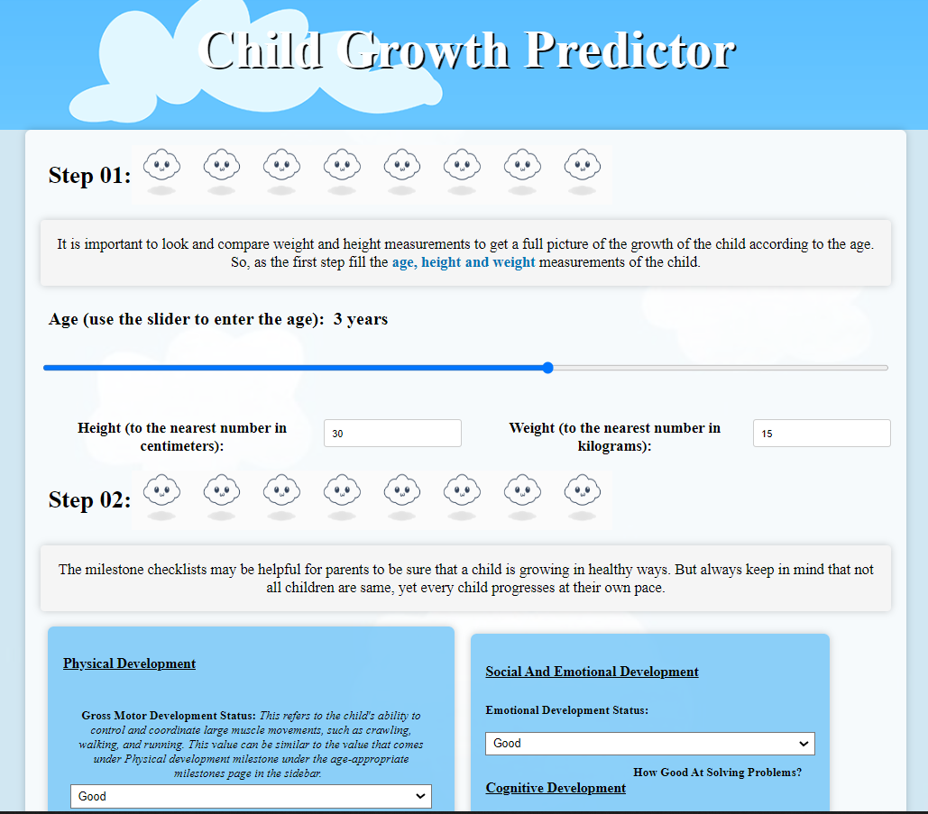
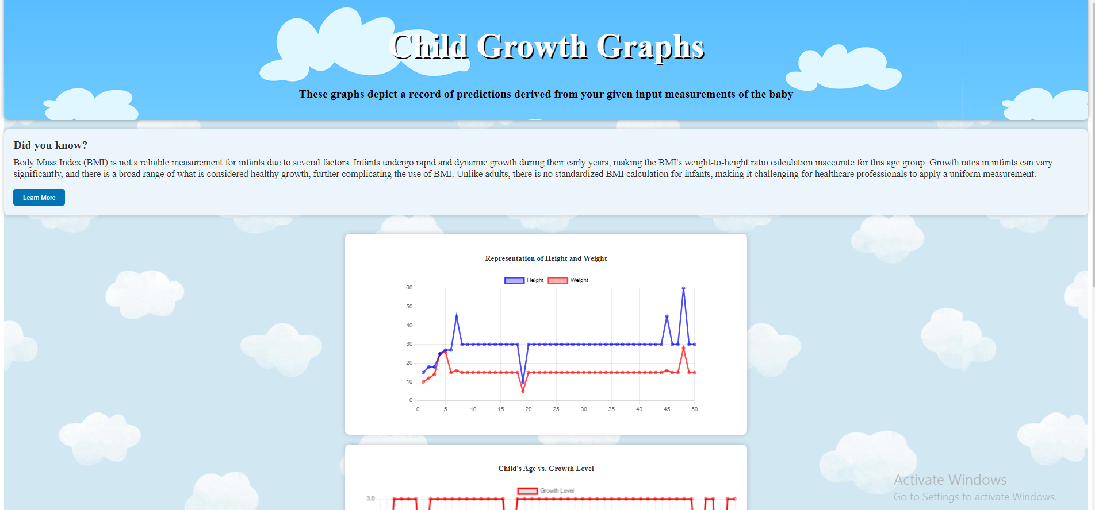
Age-appropriate activities ( 2 months – 5 years)
Home page
Growth Level Predictor
Prediction History - Graphs

Slide 48
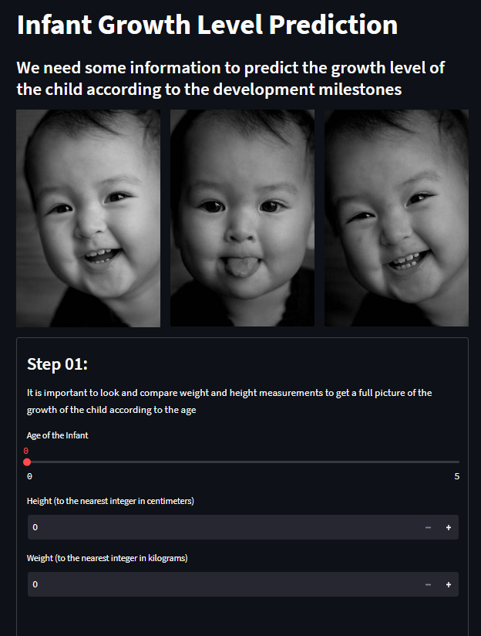
Changes of the application
The theme of the web application was changed to a light theme with the request of parents after the first round of user testing as it would be more interactive if the user interfaces are more attractive for kids.
The frontend was changed to react from Streamlit, for the integration purposes as it was not supporting for the “User Management” component.

Slide 49
System Workflow
Data collection: The system begins by gathering a dataset that includes information on the developmental stages of children aged 0 to 5. The growth prediction model is trained using the dataset as its foundation.
Data preprocessing: To extract pertinent characteristics, the collected dataset is preprocessed. The algorithm in this instance chooses particular metrics like weight, height, age, emotional development, social skills, emotional issues, and growth rate. In addition to addressing missing values, categorical variables must be encoded using LabelEncoder, and the data must be split into training and testing sets using train_test_split.
Model Training: The system trains the growth predictor model using the Random Forest Classifier method from the scikit-learn package. The selected characteristics and accompanying growth levels are included in the training dataset, which is used to train the model.
Model Evaluation: Using the testing dataset, the model is assessed after training. To evaluate the model's success, the system predicts the growth levels for the testing data and contrasts them with the actual growth levels. The accuracy_score measure is used to determine the model's accuracy.
IT20405090 | Vanhoff R.L.| TMP-23-103

Slide 50
System Workflow cont.
Model Persistence: After the model has been trained and assessed, it is stored using the pickle library in a serialized manner. The model is saved in a file along with the label encoders required to encode categorical variables.
Front-End Integration: A full-stack online application incorporates the growth prediction model. Parents can pick certain observations or activities pertaining to their baby's growth and development using checkboxes on the front-end interface.
Prediction Calculation: The system determines the score based on the number of selected actions when the user checks the appropriate checkboxes. The ratio of the number of chosen activities to the total number of potential actions is multiplied by 100 to get the score, which is then expressed as a percentage.
Forecast Interpretation: Based on the estimated %, the algorithm chooses one of four growth forecast categories (poor, fair, good, or great). For example, 80% for exceptional, 60% for good, and 40% for fair, are used as specific thresholds to determine which category a forecast belongs in.
Results Presentation: The system shows the user the growth projection category. Based on the chosen observations, the category represents the baby's growth stage. On the front-end interface, the results are displayed in an approachable manner, giving parents useful information about their child's development and the essential safety measures to be implemented.
Growth Graph Representation: The height-weight, age-growth level and prediction date – prediction result graphs are generated as per reference for the parents, to view the history of predictions.
IT20405090 | Vanhoff R.L.| TMP-23-103

Slide 51
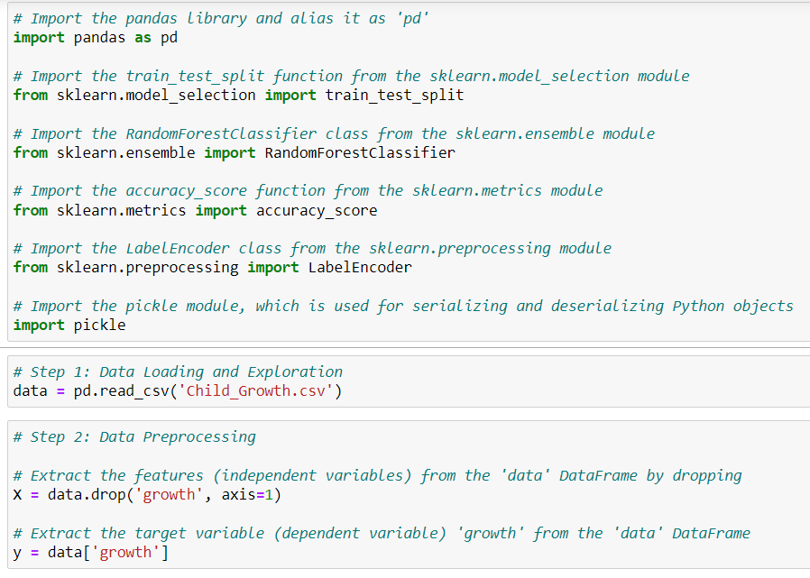
Implementation
Model Development

Slide 52
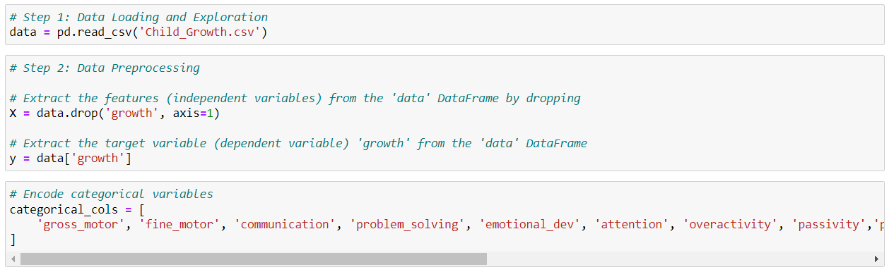
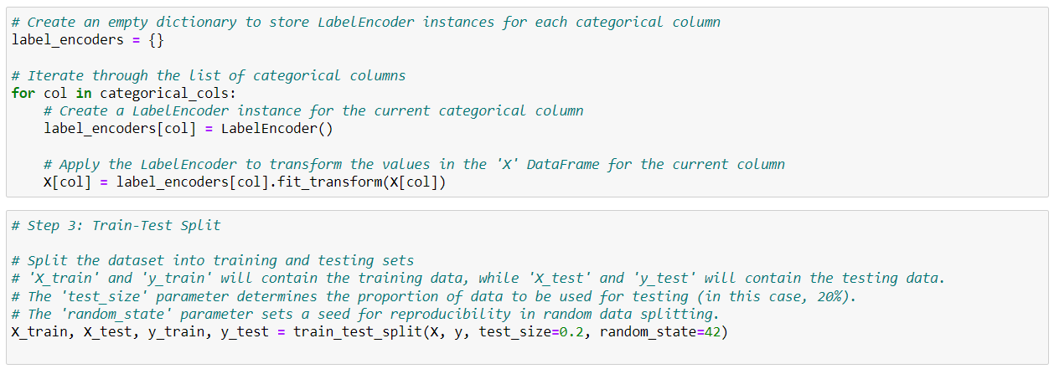

Slide 53
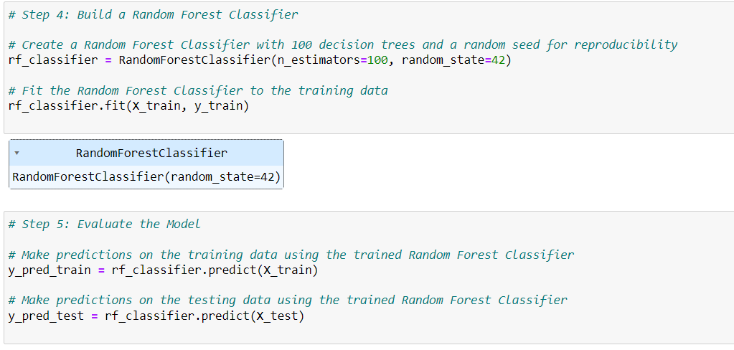


Slide 54



Slide 55



Slide 56

Backend files

Slide 57



Slide 58


Age-appropriate milestones (backend routes)
Database.py file

Slide 59



Growth Graphs

Slide 60



Growth Level Predictor

Slide 61




Child growth graphs based on the predictions

Slide 62



Age-appropriate activities for each age from 2 months to 5 years

Slide 63

IT20156374| Fernando A.P
Infant Sickness Identification through Video Processing
Software Engineering

Slide 64
Background and Literature
Introduction and Background
Infant developmental abnormalities need to be detected early in order to be treated quickly and achieve better results.
In low-resource situations, such as Sri Lanka, access to early intervention services may be restricted.
The focus of this research is to develop a system that utilizes video processing techniques to identify abnormal behaviors in infants.
The system enables parents to record videos of their infants and provides guidance on capturing specific behaviors for analysis.
By employing image processing and video processing techniques, the system analyzes the recorded videos to identify behaviors of infants.
IT20156374| Fernando A.P. |TMP-23-103

Slide 65
Background and Literature cont.
Early research indicates that newborns with ASD might demonstrate significant behavioral changes throughout the early stages of development, particularly if they spend time in the NICU.but they are more concerned about the 10 months. [1]
This study focused on babies who were born very early and had very low birth weights. It was shown that these premature infants had large gray matter and cerebrospinal fluid volume decreases in their brains, which were connected to developmental problems in the first year of life.[2]
This study concentrated on full-term infants at 2 years of corrected age and very preterm infants (born before 30 weeks of gestation or with a birth weight under 1,250 grams). It sought to contrast their social and emotional challenges and prowess. This study emphasizes the possibility of behavior issues and early difficulties with social and emotional development in very preterm newborns.[3]
This study analyzes a novel technique termed the assessment of general movements (GMs) as a means to predict developmental abnormalities in infants, such as cerebral palsy (CP), and addresses the significance of early diagnosis of these diseases. The study shows that CP can be strongly predicted by the quality of GMs in newborns at two to four months post-term. [4]
IT20156374| Fernando A.P. |TMP-23-103

Slide 66
Objectives
Main Objective - :
To detection and development of a system to support parents by recognizing and informing them of problematic behaviors in babies using video processing techniques.
Sub Objective - :
To enhanced monitoring: The system allows parents to actively monitor their infants for potential illnesses.
To early detection: By capturing and analyzing abnormal behaviors, this can help to early detection of sicknesses.
To peace of mind: This system empowers parents with a valuable tool to ensure the well-being of their infants.

Slide 67

Research Problem
What are the abnormal behaviors can predict?
e.g Autism Spectrum Disorder (ASD) in Infants
Social Interaction
Normally, Infants interact socially with their parents by making eye contact, smiling responsively, and responding to their names(Normal behavior).
But Abnormally, Infants with ASD may exhibit limited engagement with others, avoid eye contact, and show less interest in social relationships.
2. Communication:
Normal Behavior: Babies often start babbling, copying sounds, and trying to communicate their needs through gestures and vocalizations.
Abnormal Behavior: might exhibit delays in speech development, limited babbling, and reduced attempts to communicate or share attention
Likewise can be identify via recorded videos, the behaviors of communication, Social Responsiveness, Eye Contact.
IT20156374 | Fernando A.P. |TMP-23-103

Slide 68






Component Overview
Diagram
Input video of the infants
Video recording by the parents according to the guidelines of the system
Web cam
Abnormal behaviors detecting
Video processing and analyzing
Smart phone
Results
output
IT20156374 |Fernando A.P.| TMP-23-103

Slide 69
Methodology
Datasets – Video datasets with abnormal and normal behaviors of babies
Prediction Model
Technologies Involve – Python, OpenCV (cv2), NumPy, TensorFlow, Keras, Matplotlib, MoviePy, scikit-learn (sklearn), pafy and Various Python libraries for file and data manipulation
TensorFlow/Keras, which enables the development of deep learning models, and OpenCV, which processes video frames, form the foundation of this approach. The LRCN (Long-term Recurrent Convolutional Networks) model architecture is employed in the code, which seems to be a component of a video-based classification challenge. In order to classify sequences of video frames, this model mixes recurrent neural networks (RNNs) and convolutional neural networks (CNNs).
IT20156374 |Fernando A.P. | TMP-23-103

Slide 70
Methodology cont.
System Implementation
Video recording and processing with Database Connection
Make Prediction
Video recording and processing with Database Connection
Technologies Involve
OpenCV (cv2),
React Js (basically for frontend development)
Python Standard Libraries eg: subprosess, datetime
Video Encoding Libraries (e.g., H.264)
MongoDB (MongoDB Atlas) for Database Communication
Make Prediction
Technologies Involve
Python, OpenCV (cv2), NumPy, TensorFlow, Keras, PIL (Python Imaging Library), HTML/CSS (via Streamlit)
Jupyter Notebook
Visual Studio Code
IT20156374 |Fernando A.P. | TMP-23-103

Slide 71



Developed solution
Dataset Training and model for make prediction

Slide 72


Developed solution cont.
Main application - Backend
IT20156374 | Fernando A.P. |TMP-23-103

Slide 73


Developed solution cont.

Slide 74
Results and Discussion
Model Results and Accuracy of prediction
Used two models
LRCN Model (Long-Short Term Memory Convolutional Neural Network)
ConvLSTM Model (Convolutional Long-Short Term Memory Model)
LRCN Model | ConvLSTM Model | Results
designed to analyze sequences of video frames and make predictions about infant behavior. | designed to analyze sequences of video frames and make predictions about infant behavior. | Same purpose
uses a combination of Convolutional Neural Networks (CNNs) to extract spatial features from individual frames and Long Short-Term Memory (LSTM) layers to capture temporal dependencies between frames in a sequence. | uses ConvLSTM layers, which combine the spatial feature extraction capability of CNNs with the sequential modeling ability of LSTMs. | Different Architectures
IT20015244 | Wijesinghe R.M.U.S | TMP-23-103

Slide 75


Results and Discussion cont.
LRCN Model | ConvLSTM Model | Results
takes a sequence of video frames as input, where each frame is resized, normalized, and processed. | it takes a sequence of video frames as input, which are resized and normalized. | Same input taken
The model is trained on a dataset of videos, with labels indicating whether the infant behavior is abnormal or normal. With Accuracy of : 1/1 [==============================] - 2s 2s/step - loss: 0.6861 - accuracy: 0.7308 Test Loss: 0.6861181855201721, Test Accuracy: 0.7307692170143127 | The model is trained on a dataset of videos with behavior labels . With Accuracy of : 1/1 [==============================] - 1s 1s/step - loss: 0.3673 - accuracy: 0.8462 | High accuracy rate in ConvLSTM Model
IT20015244 | Wijesinghe R.M.U.S | TMP-23-103

Slide 76


Results and Discussion cont.
Due to its specialized layers, the ConvLSTM model is more complicated and may be able to detect more complex patterns in video sequences.
IT20015244 | Wijesinghe R.M.U.S | TMP-23-103

Slide 77


Results and Discussion cont.
System Results and prediction outputs
IT20015244 | Wijesinghe R.M.U.S | TMP-23-103

Slide 78




IT20015244 | Wijesinghe R.M.U.S | TMP-23-103

Slide 79
References
[1] B. Z. Karmel et al., “Early Medical and Behavioral Characteristics of NICU Infants Later Classified With ASD,” Pediatrics, vol. 126, no. 3, pp. 457–467, Sep. 2010, doi: https://doi.org/10.1542/peds.2009-2680.
[2]T. E. Inder, “Abnormal Cerebral Structure Is Present at Term in Premature Infants,” PEDIATRICS, vol. 115, no. 2, pp. 286–294, Feb. 2005, doi: https://doi.org/10.1542/peds.2004-0326.
‌
[3]A. J. Spittle et al., “Early emergence of behavior and social-emotional problems in very preterm infants,” Journal of the American Academy of Child and Adolescent Psychiatry, vol. 48, no. 9, pp. 909–918, Sep. 2009, doi: https://doi.org/10.1097/CHI.0b013e3181af8235.
[4]M. Hadders-Algra, “Evaluation of Motor Function in Young Infants by Means of the Assessment of General Movements: A Review,” Pediatric Physical Therapy, vol. 13, no. 1, p. 27, 2001, Accessed: Sep. 04, 2023. [Online]. Available: https://journals.lww.com/pedpt/Fulltext/2001/04000/Evaluation_of_Motor_Function_in_Young_Infants_by.5.aspx
‌
‌
‌
IT20015244 | Wijesinghe R.M.U.S | TMP-23-103

Slide 80

User Testing
Name – Piumie Fernando
Work at – Wijaya Kumarathunga Hospital Seeduwa
Position – Registered Nurse

Slide 81






User Testing

Slide 82
Thank You!
Team TMP 23-103

Slide 83
References
https://docs.google.com/forms/d/1TJVybNbdRg48Lhw0M3R409Kt1C_3MbFT4PGikabBIdk/edit
https://forms.gle/WiGeL2PiZaiYS1Ax7
https://forms.gle/Yw2a7MAyPUeTHSj99

